Slide 1
Emerging Technologies
Term Project Presentation
Project Title : Collab
Group 3
Student Name: Affida Haseeb
Student ID: C0812614

Slide 2
Introduction
The idea behind creation of ‘Collab’ is a Project Management web application, developed to make collaborating easier. It provides a platform where users can login and work together on a single project such that any changes or updates from one member will be accessed by all the members of the team. This reduces the need for redundant file sending and updating for each member of a team. This saves time and increases efficiency in group work and incorporates a sense of organized monitoring of each and every step of the progress of projects.
Notes:
The main focus of our project was to create a dashboard or a source where everyone in the company can access the files. So, now a days we are using cloud platform to store large datas into it.
We have taken an example from the cloud collab, which google has released in which we can use the cloud for free.

Slide 3
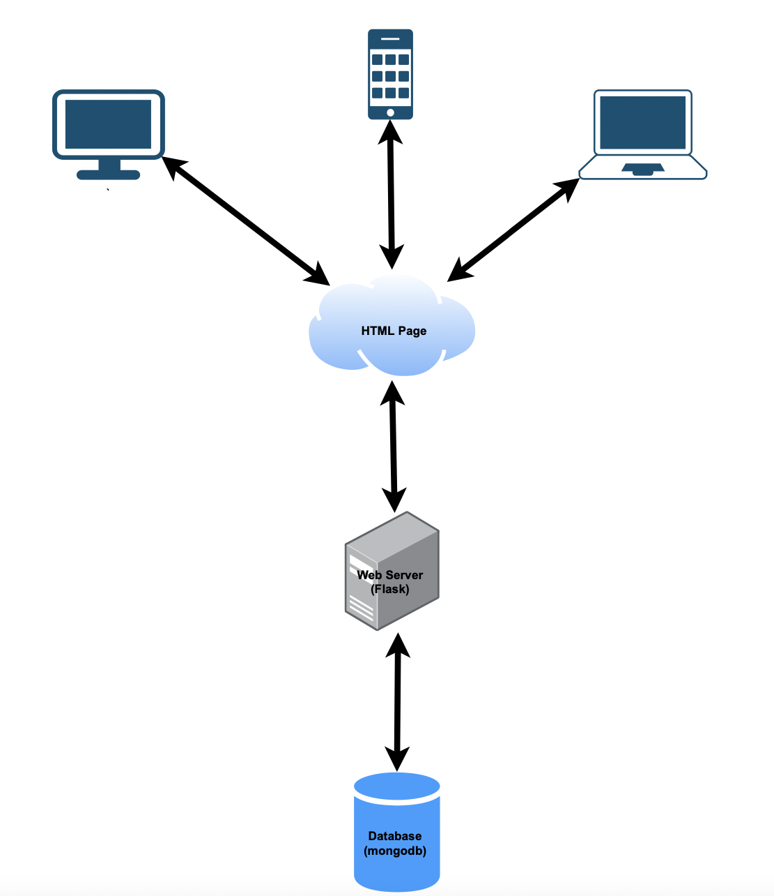
Basis of Collab
To create any web application, we require the front-end for interaction with the users. To enable interactivity, we require a server and a database for storage of information which can be pulled up by a trigger from the server. In this project, we made use of the following:
Html
JavaScript
Css
MongoDB
Pycharm for code editing
Flask ( to run the project on server)
Heroku (for deployment of the app)
Python packages like pymongo, python-dateutil, dnspython
Notes:
We have created this project using different technologies, it has front-end, backend and the database connected to it. In Front end we used html, CSS and JavaScript to give realistic view to the users.
For backend we have used python, flask for the development As database we used MongoDB as taught in the class as nosql database. Heroku is used to publish he website online.

Slide 4
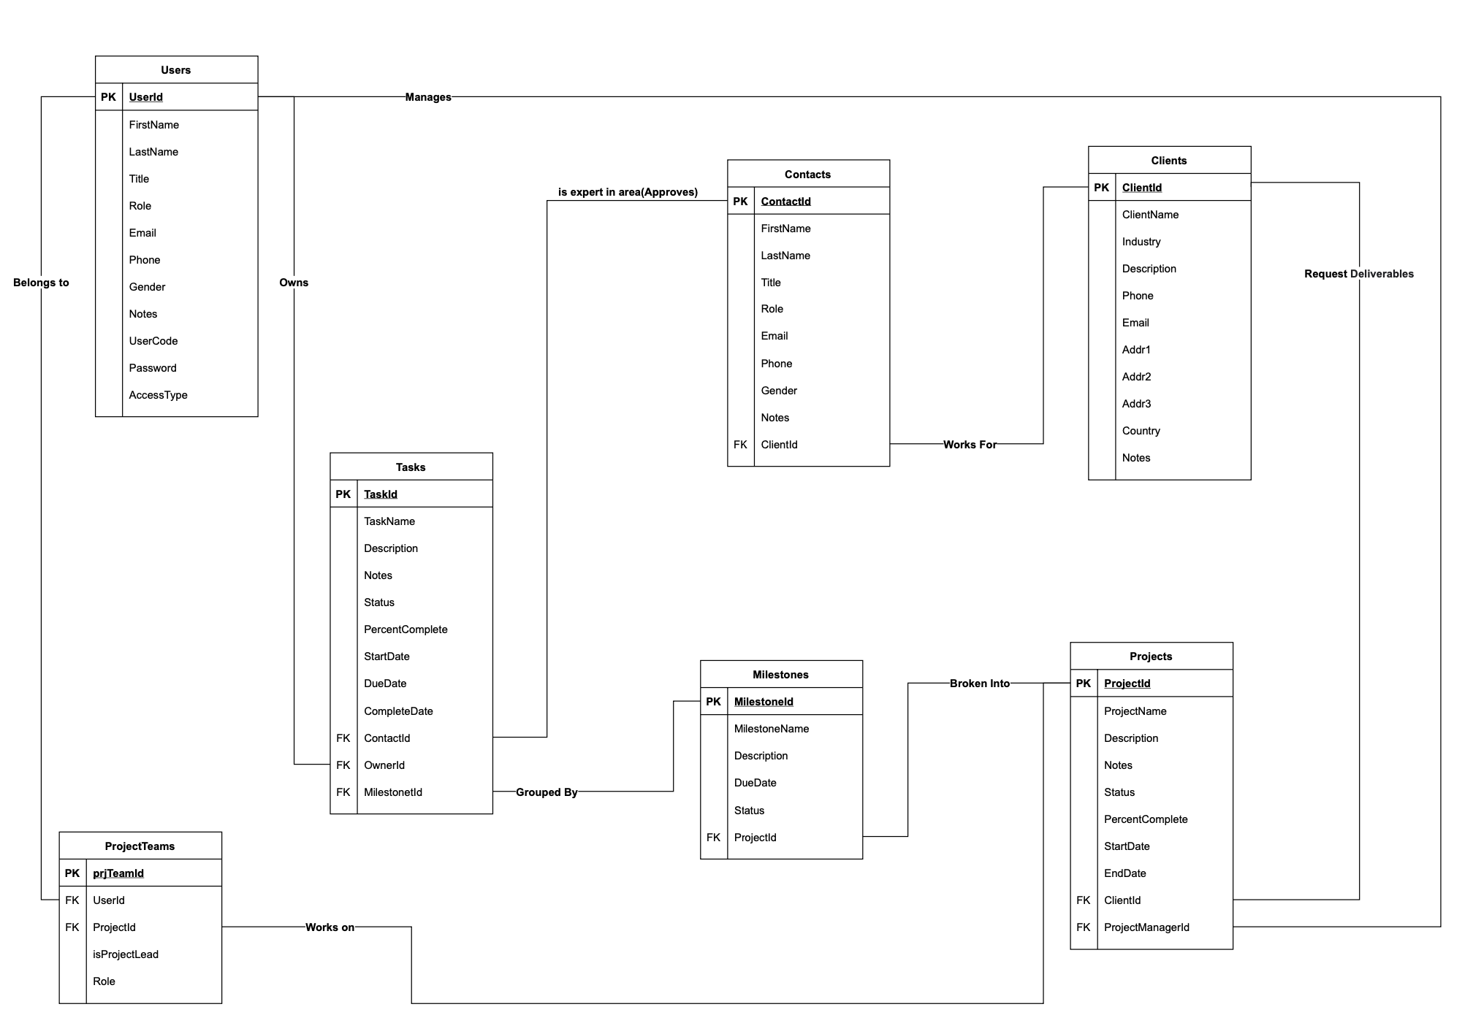
Structural View of Collab
Notes:
The basic structural representation of our project – COLLAB. It shows how, the users, clients, projects, tasks are interconnected to eachother.

Slide 5
Implementation
Login Page
Dashboard
Access Types and views
Projects Functionality
Deployment using Heroku
Proposed Future Enhancement
Notes:
In this slide will show, how we began implementing.

Slide 6
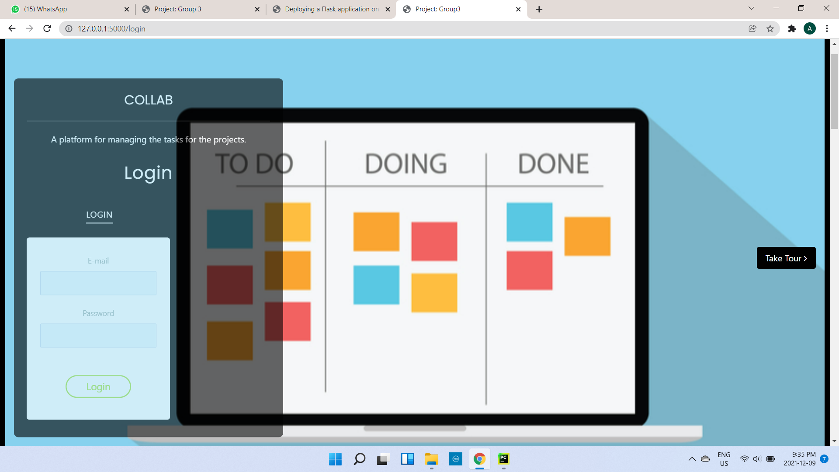
Login Page
Notes:
For the login page, every member of our group has its own log in credentials which are stored in the database.

Slide 7
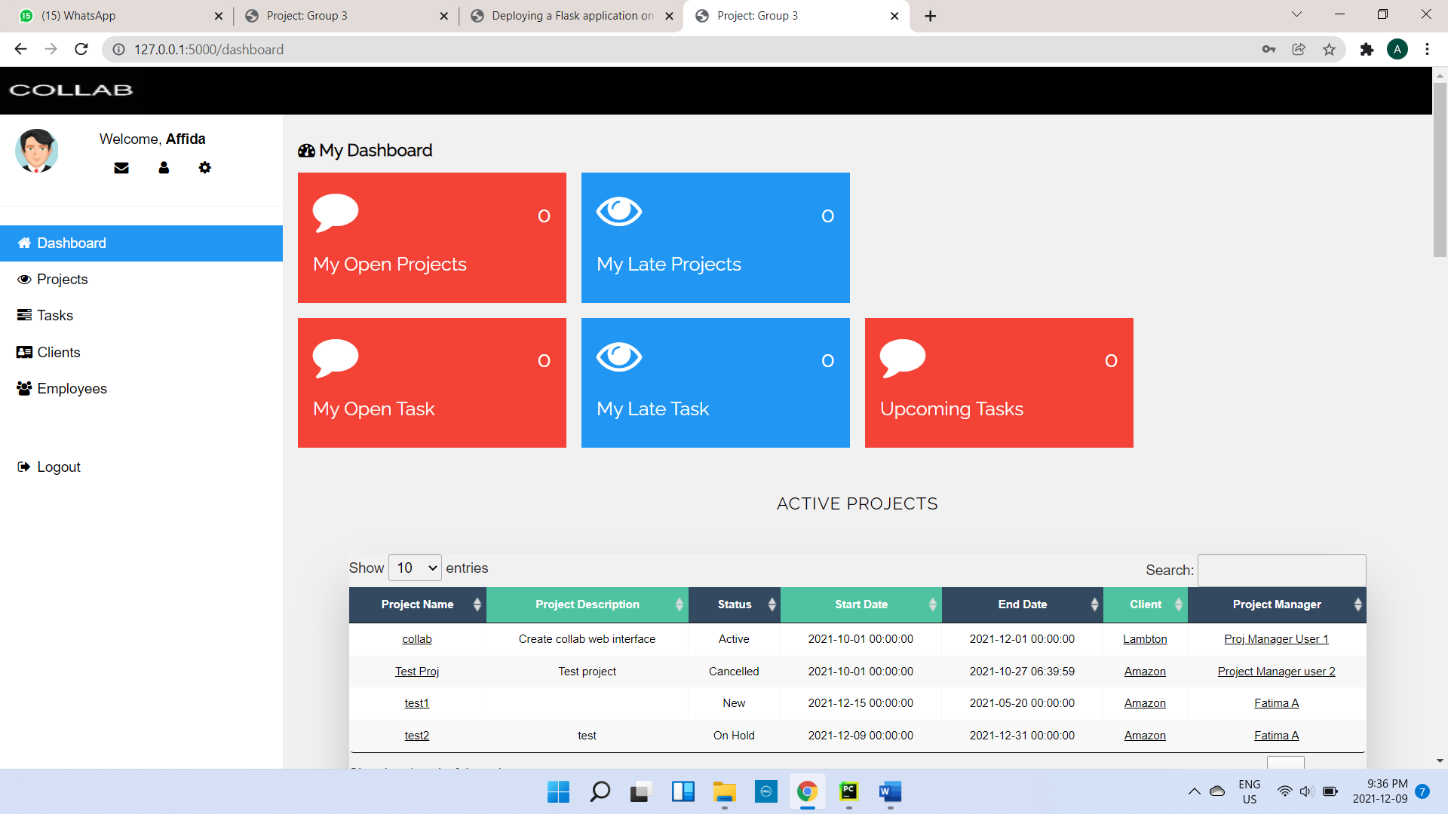
Dashboard
Notes:
The dashboard will show all the works, tasks which was assigned to me. When I logged into my system It will show me the welcome message with my name.

Slide 8
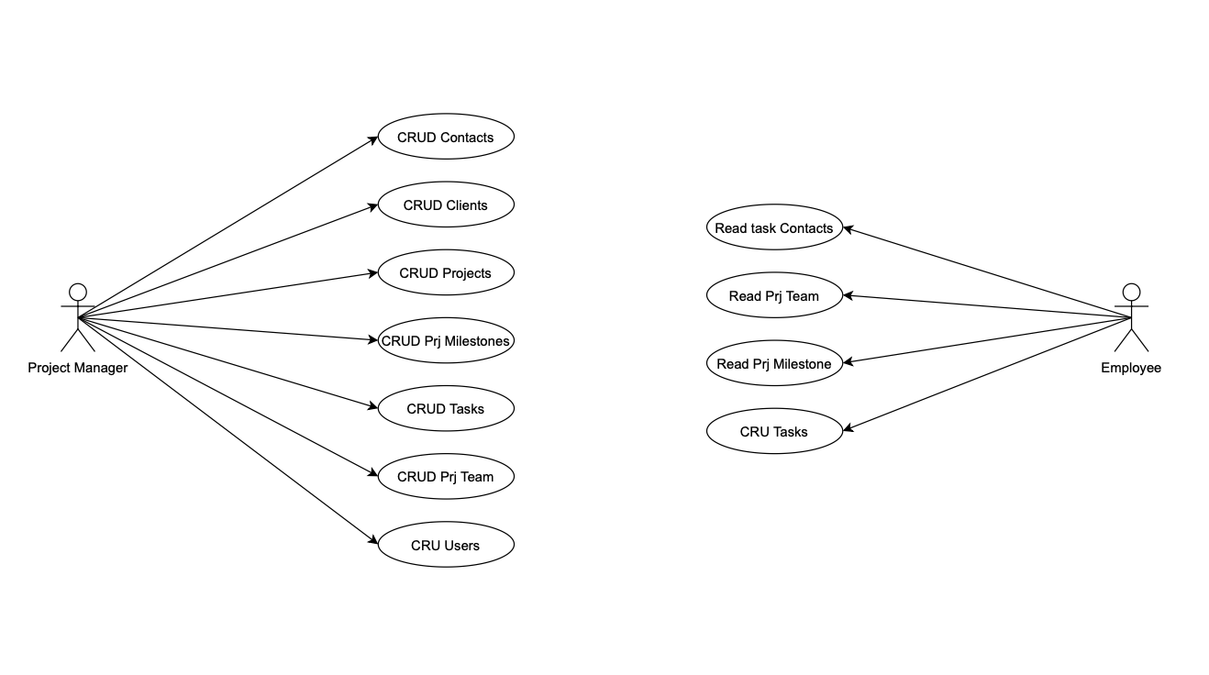
Access types and views
The figure depicts how an employee access is limited to viewing contacts, project team, milestones and Create, Update or Read Tasks. On the other hand, the project manager in Collab has the ability to view and manipulate more things, Create, Read, Update and Delete are the CRUD functions of any web application. In Collab, a project manager may CRUD contacts, clients, projects, milestones, tasks, project team, as well as users. This employs the idea of an admin of a project and their authority over a team.
Notes:
This slide depicts how the employee is having access to few things compare to the project manager

Slide 9
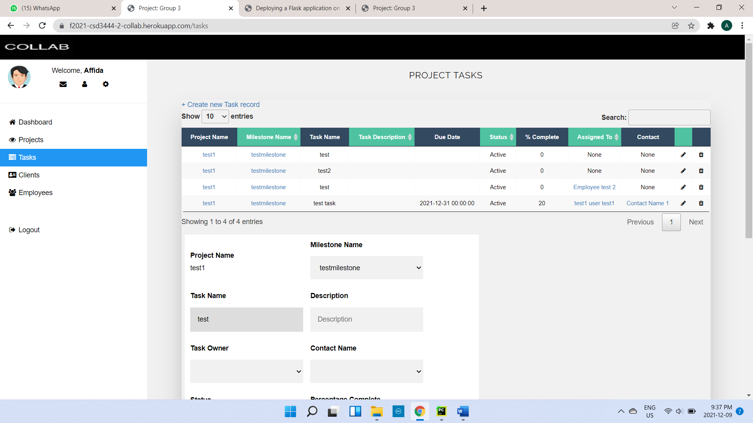
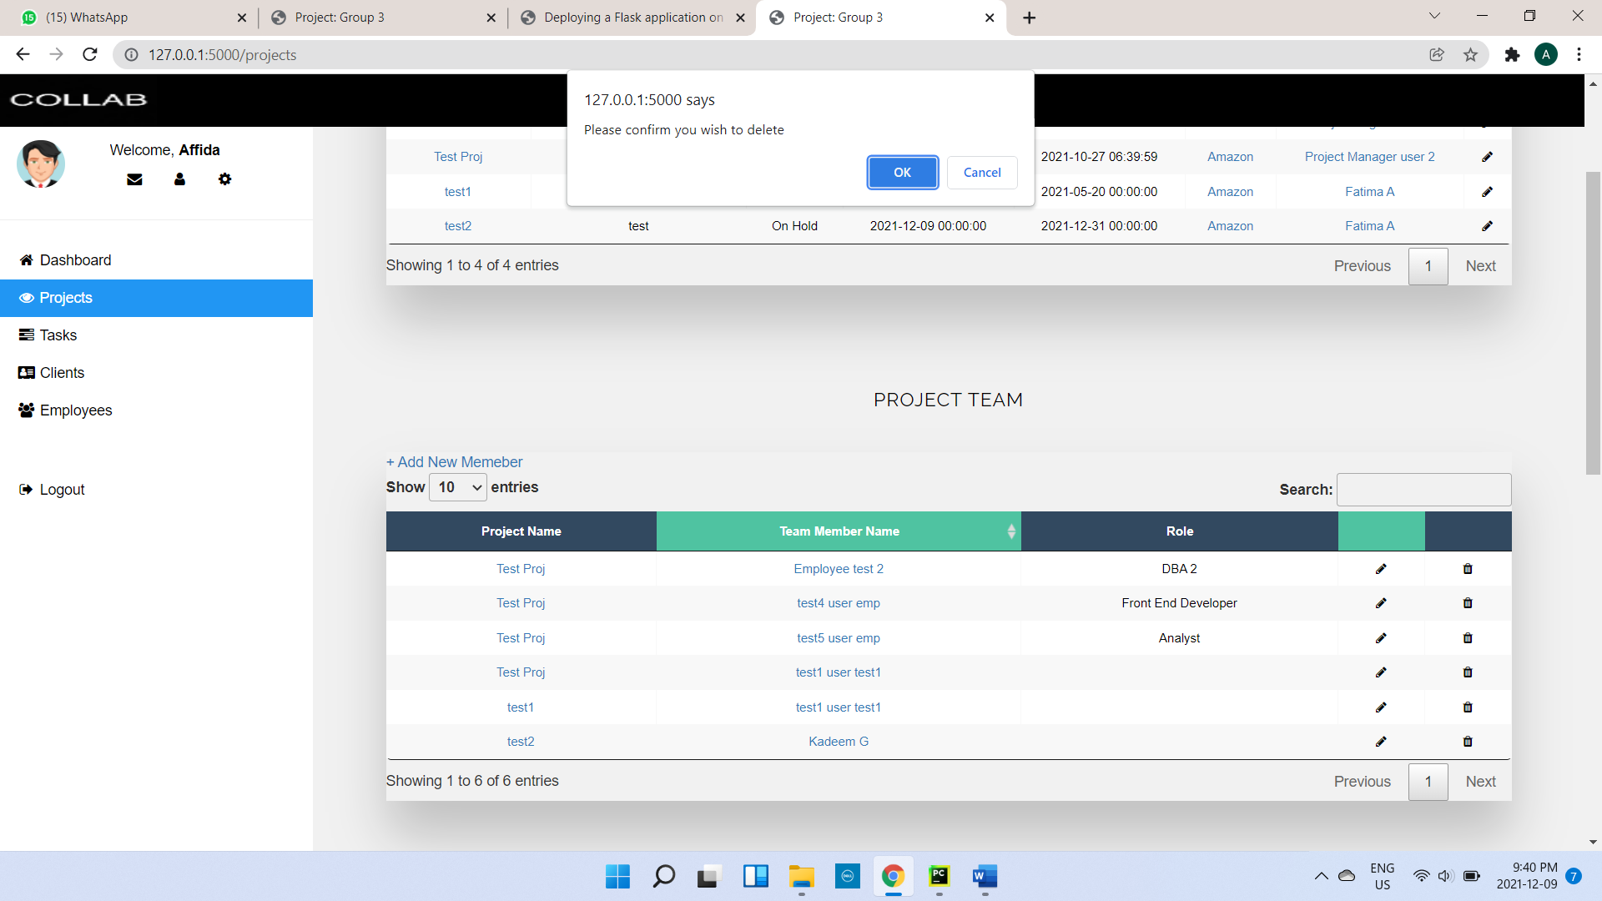
Functionality of Projects
Create, Read, Update
Delete
Notes:
I have used CRUD operations, We can create new data and store in database, we can read the data, we can update it and delete it from the database.

Slide 10
Deployment using Heroku
For our project implementation, we deployed the Software as a Service to Heroku. It works similar to Git where we create a report and then commit and push to the server.
Publish link:
https://f2021-csd3444-2-collab.herokuapp.com/login
Notes:
We have published our project using Heroku.
References:
https://medium.com/@gitaumoses4/deploying-a-flask-application-on-heroku-e509e5c76524
Publish link: https://f2021-csd3444-2-collab.herokuapp.com/login

Slide 11
Proposed Future Enhancement
Acquire an online server (for example: Microsoft Azure) - Install it and then run the application on that machine. We will need to acquire a public IP address & configure a DNS name to point to the service being ran.
Decouple the different pieces (the database tier, middle /python controller layer and the front-end code) and publish to be ran as separate services.
Implementation of various security features in the cloud
A cascading delete would be best so the reference to that object is removed from all related components. For example, if we were to delete a project, all the tasks associated with that project should also be deleted.
Notes:
These are the future enhancement, my team will work if we get an chance in future.

Slide 12
THANK YOU!

